Slide 1
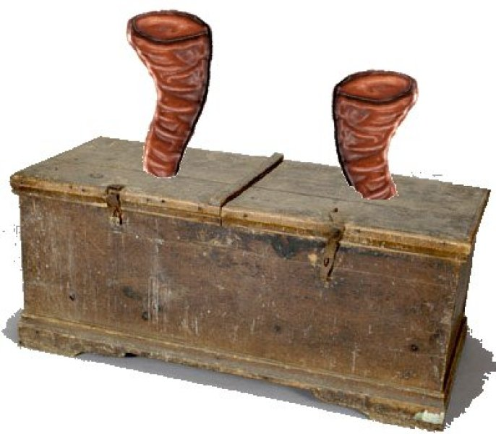
Temple Treasure Chest

Slide 2
