Slide 1
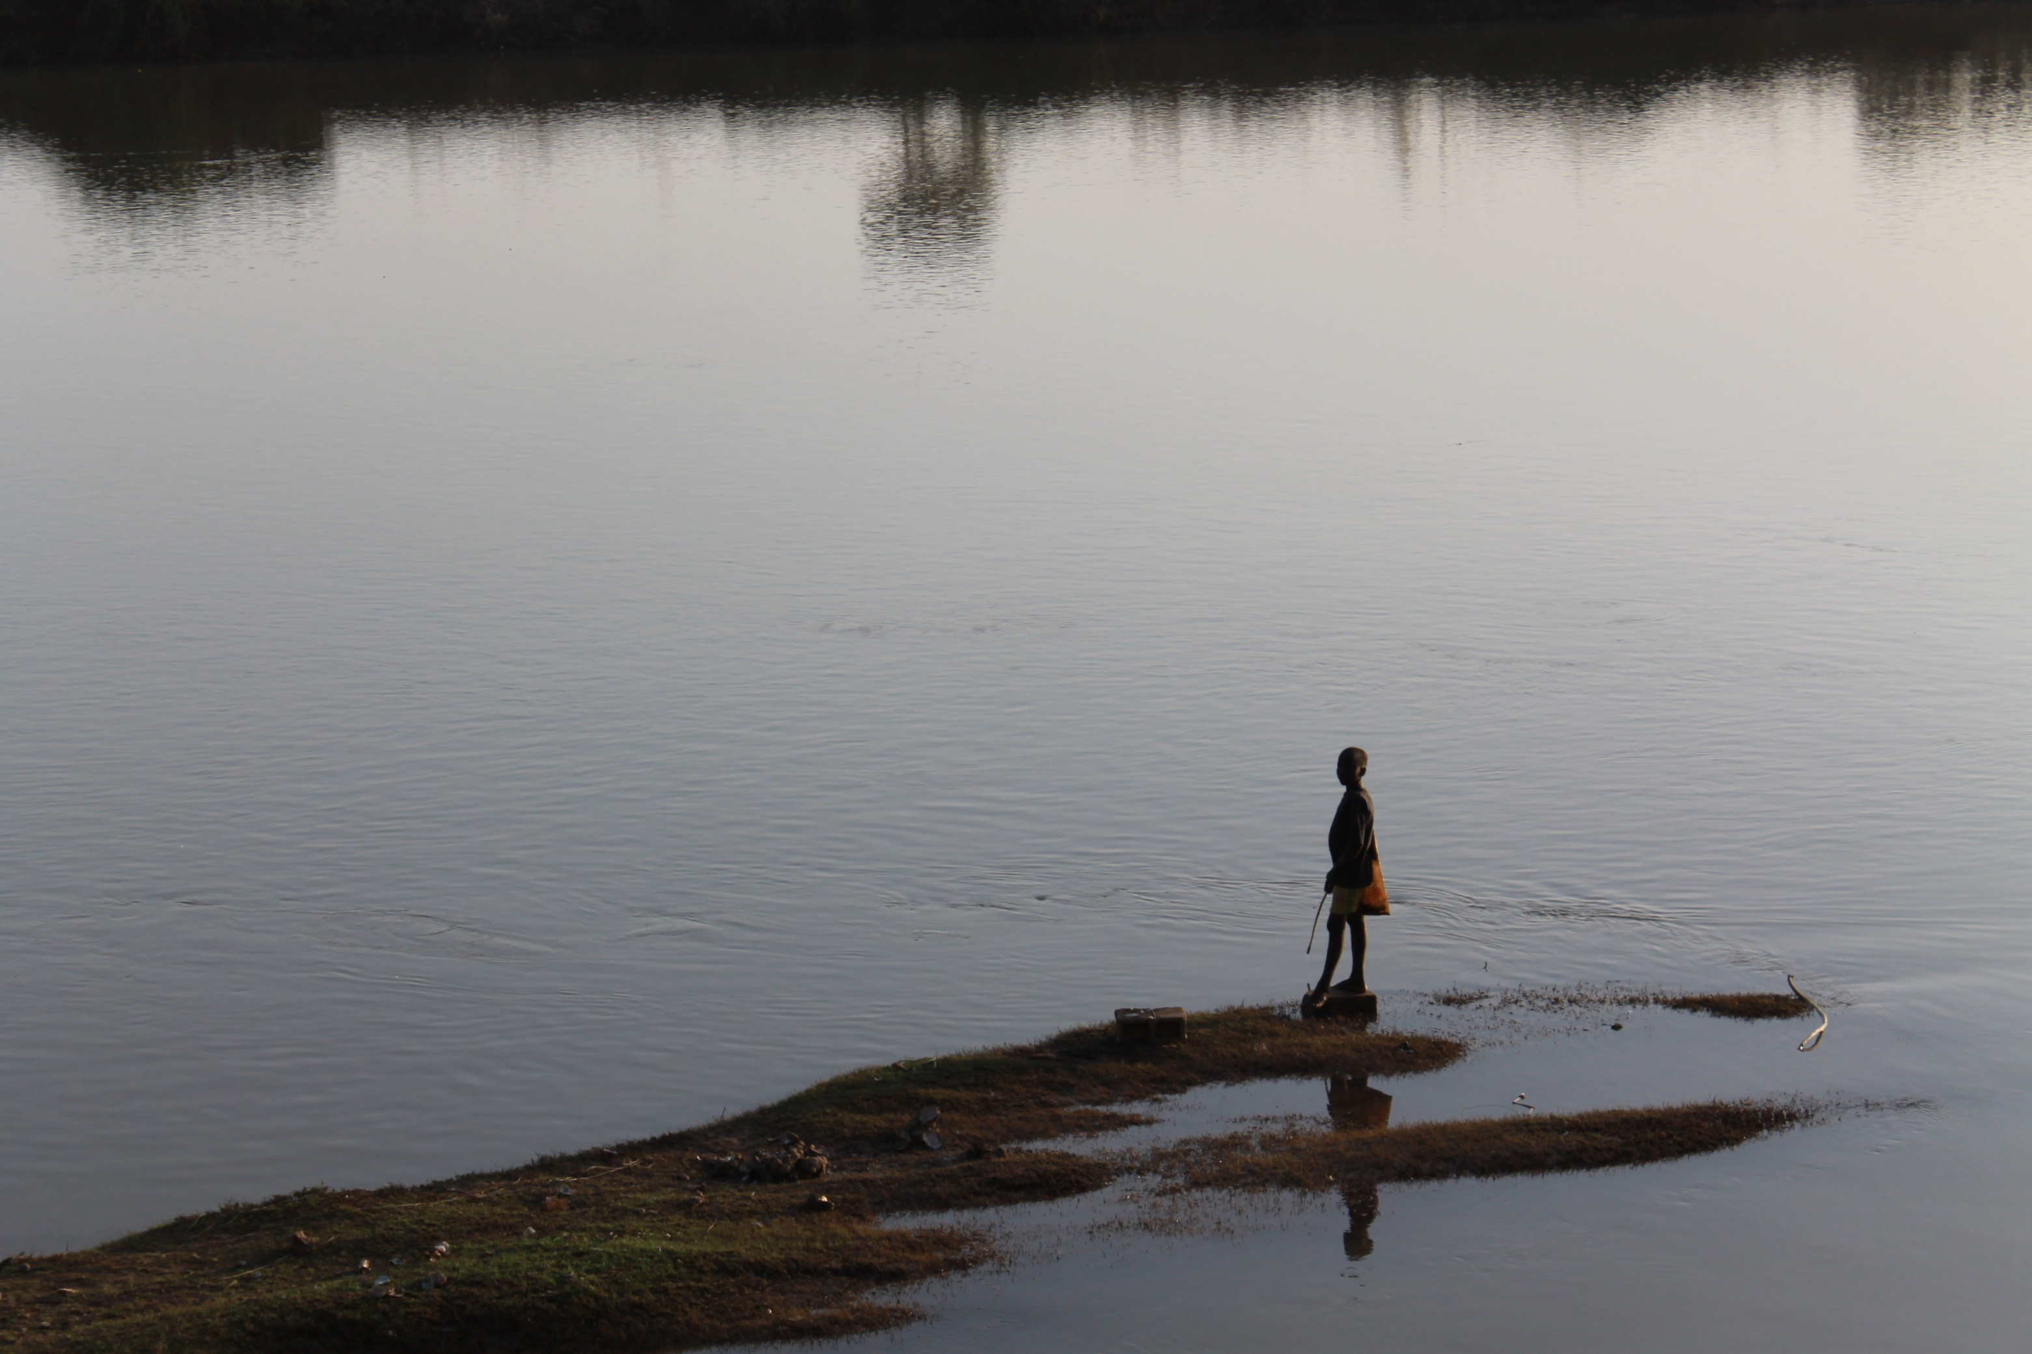
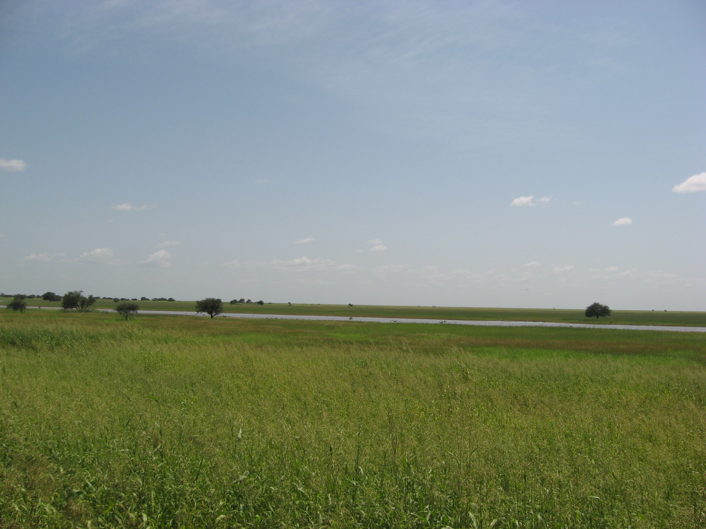
…because so many don’t have it!
college student went to Guatemala

Slide 4
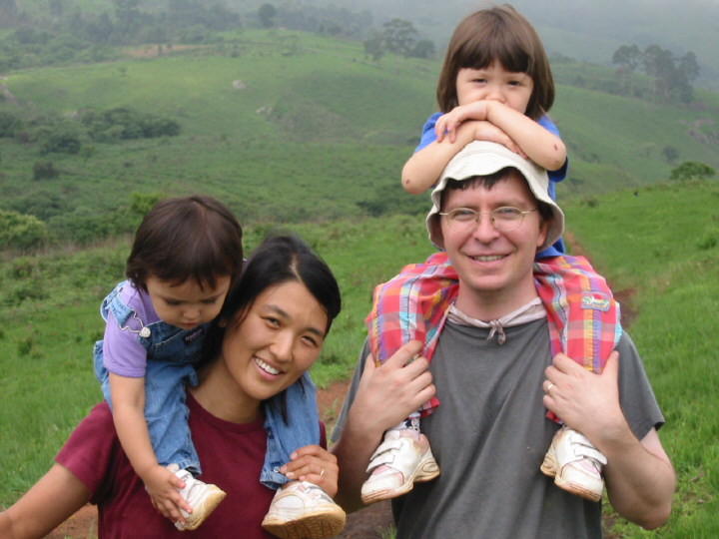
Why translate the Bible?

Slide 5
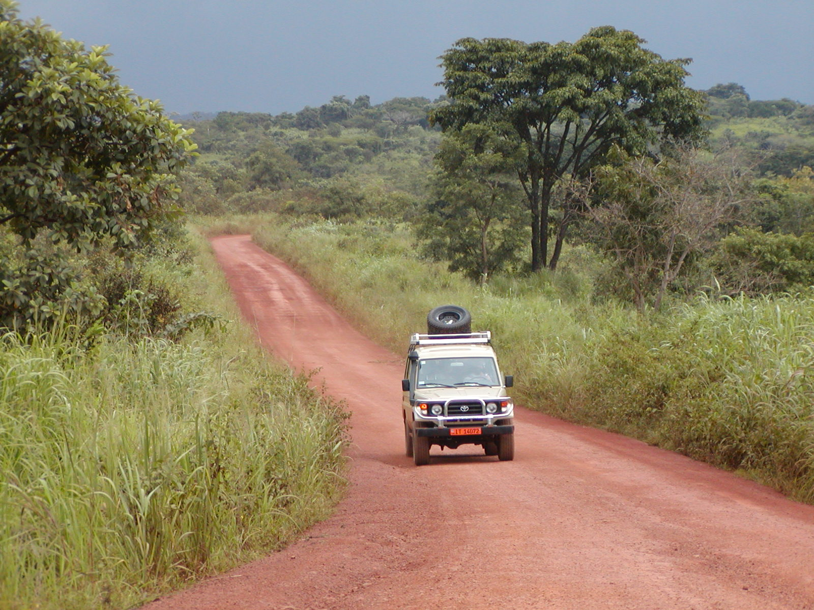
Why translate the Bible?

Slide 6
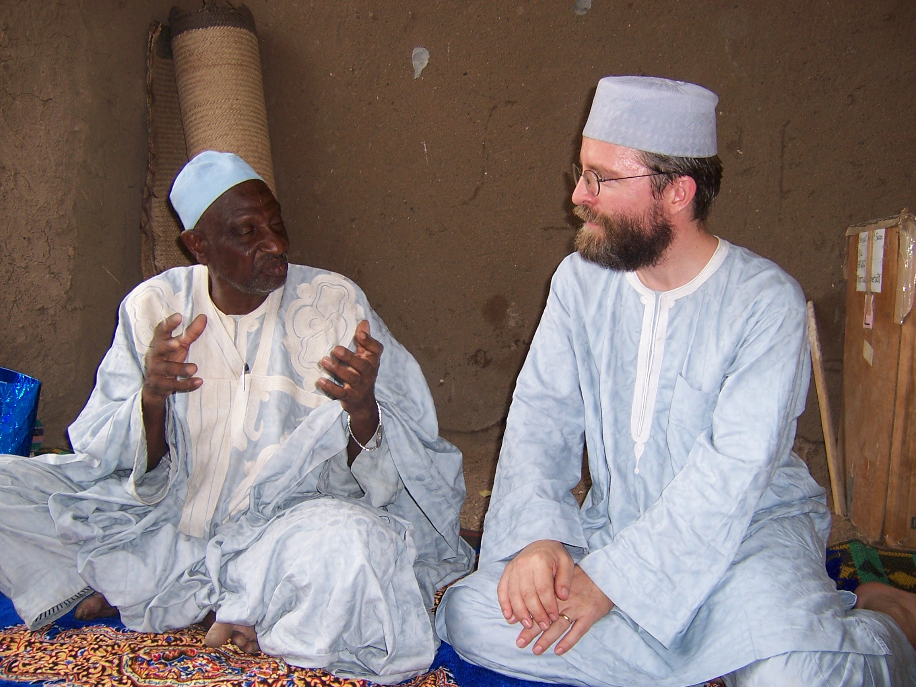
Why translate the Bible?

Slide 7
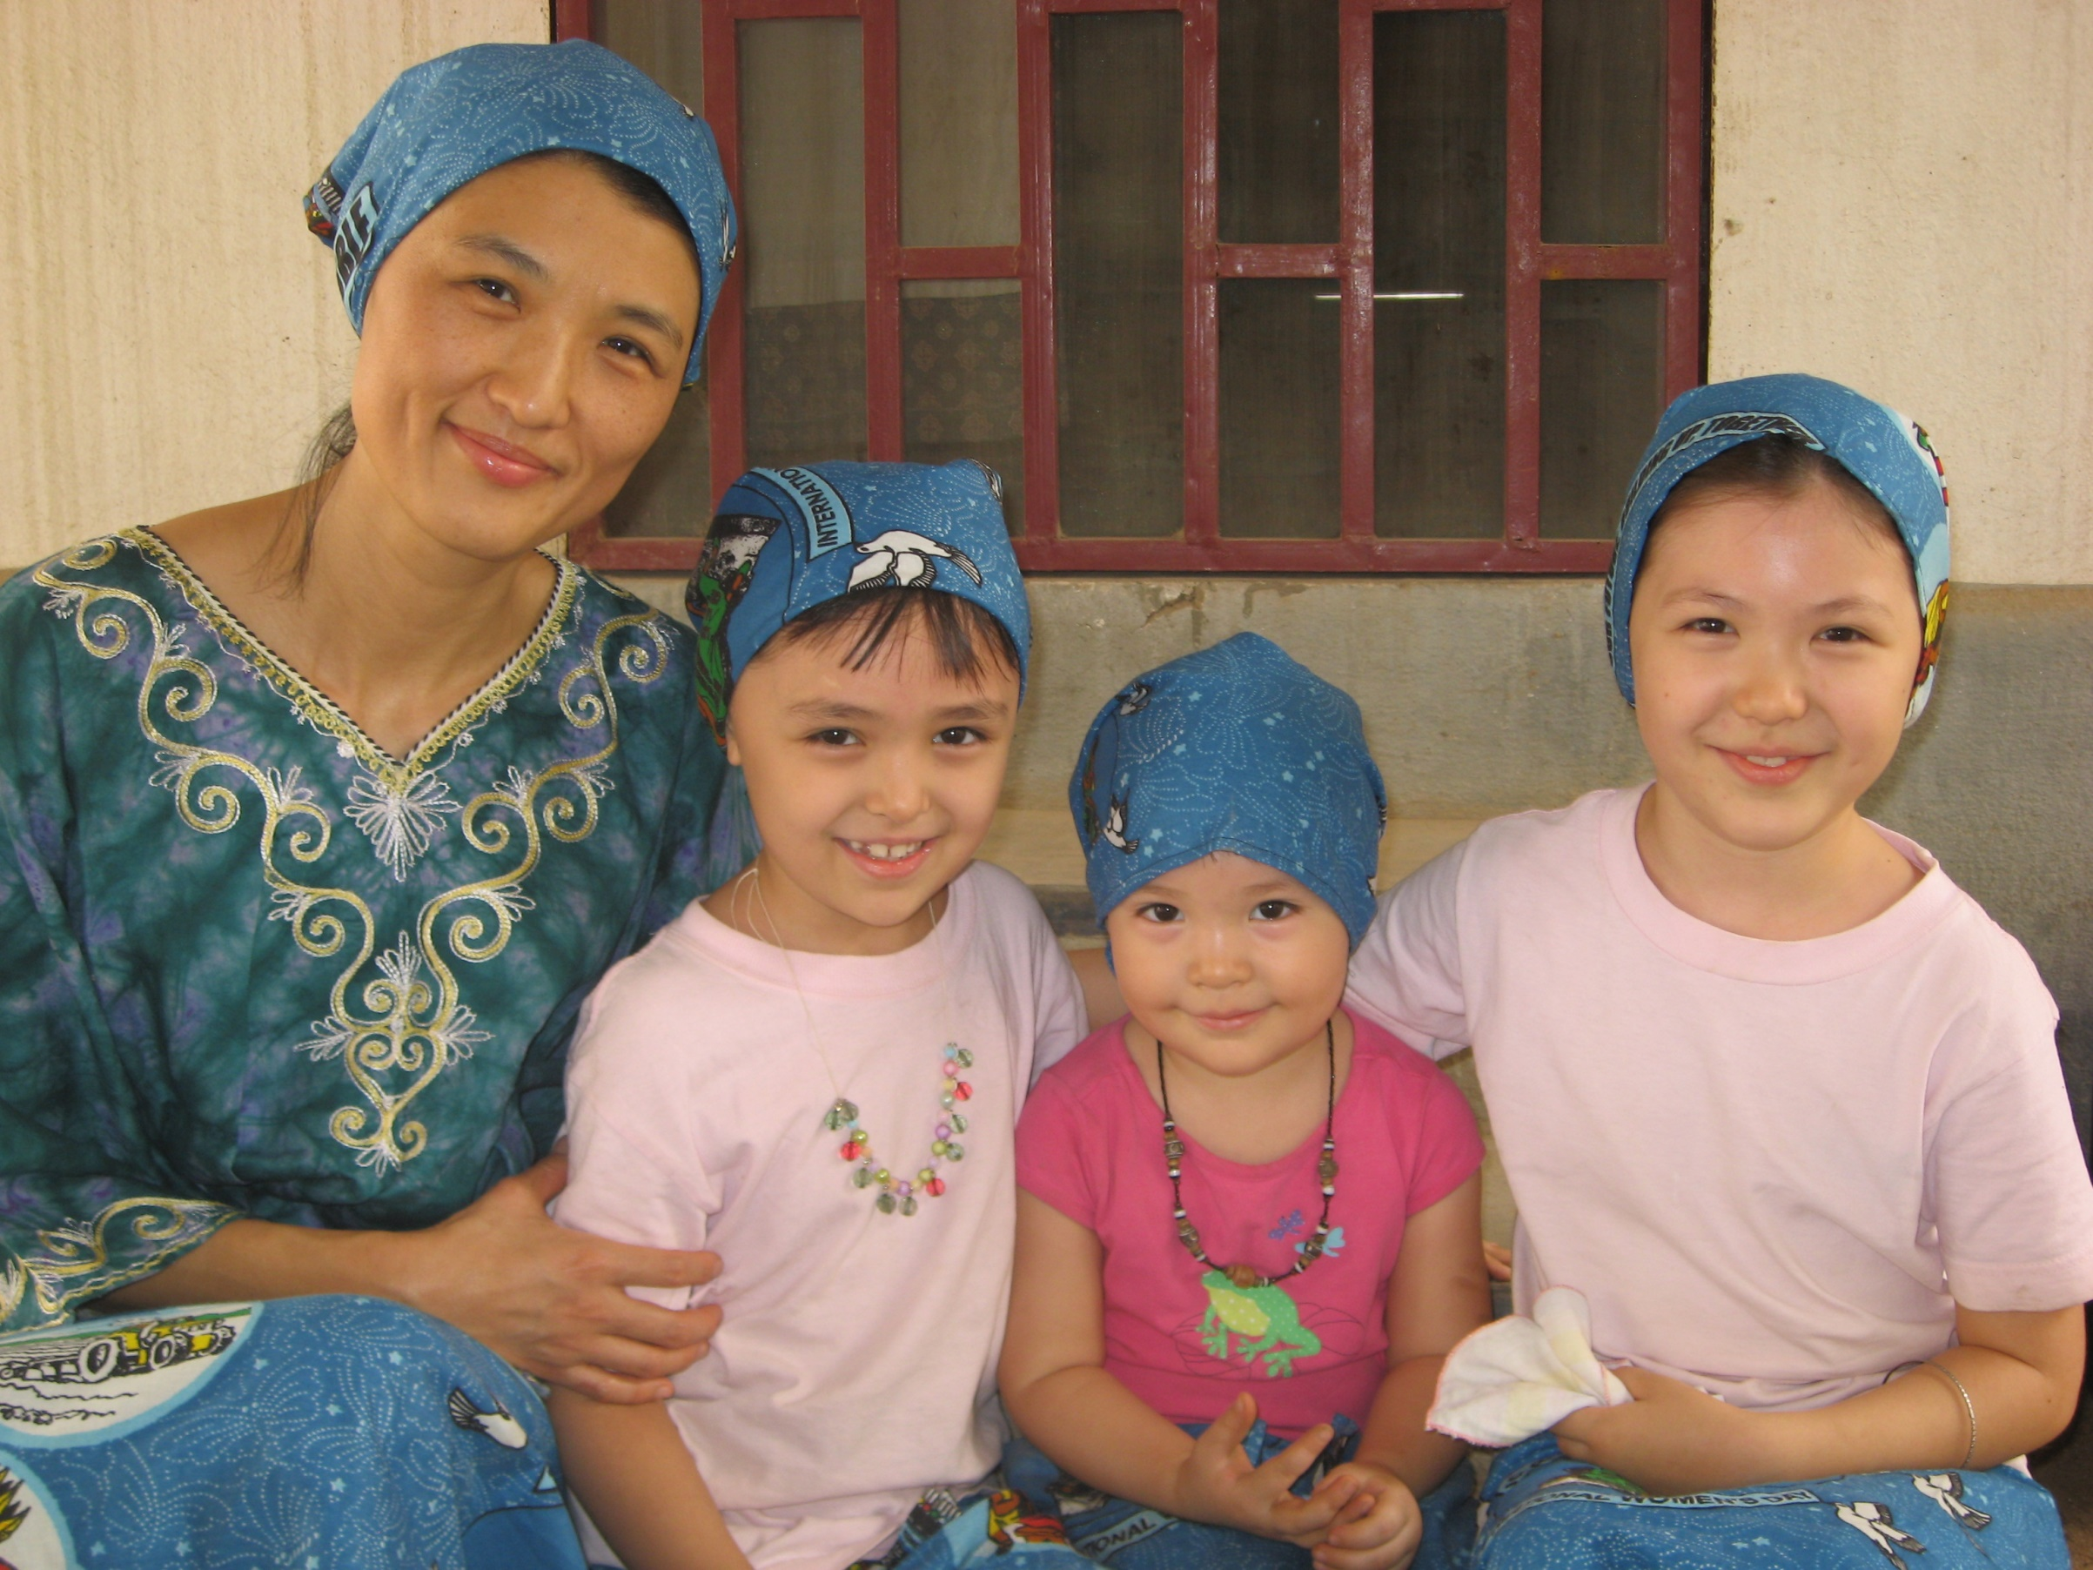
Why translate the Bible?

Slide 8
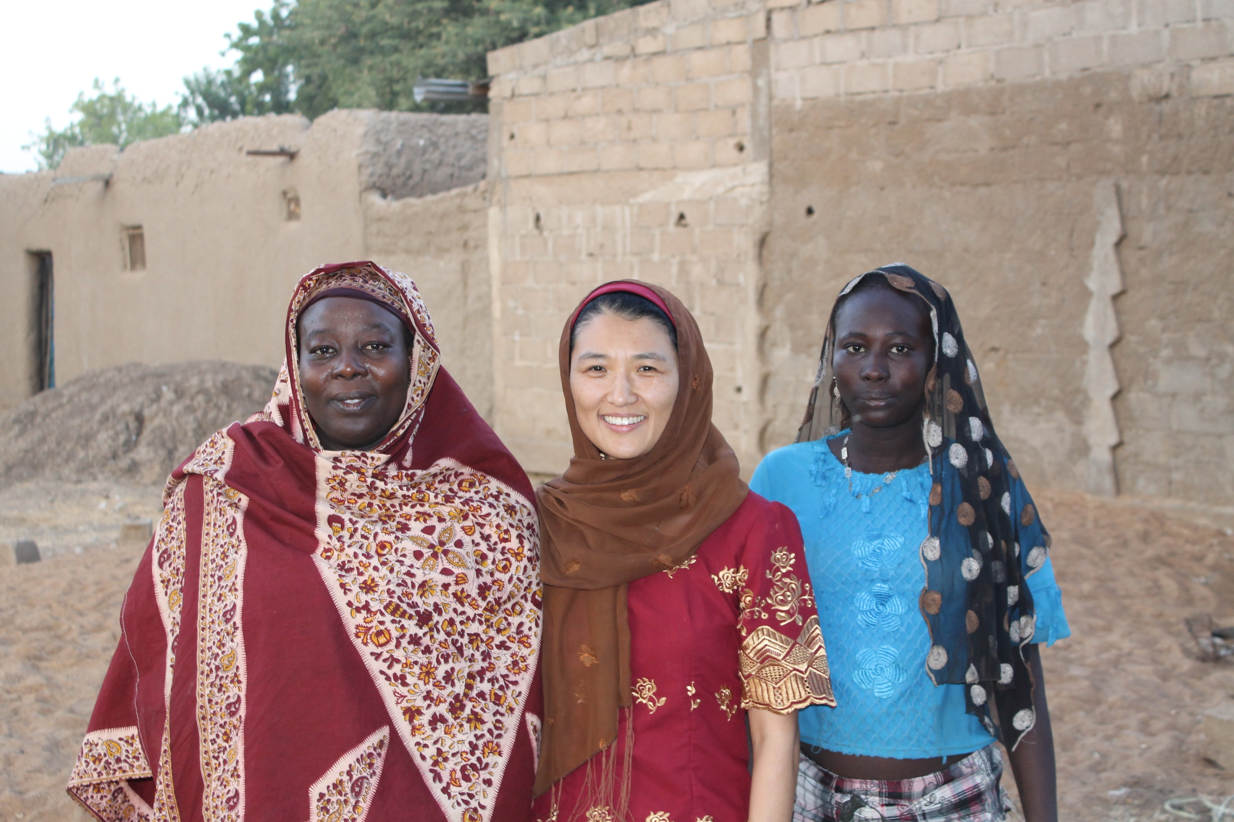

Slide 9
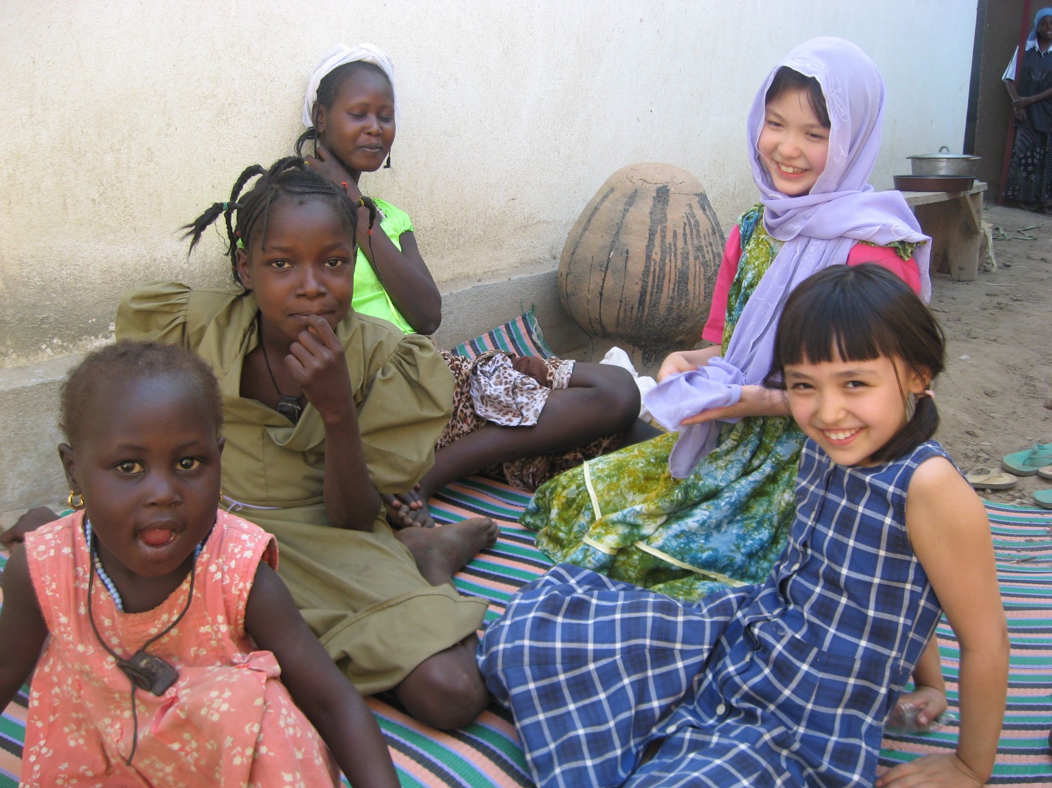

Slide 10
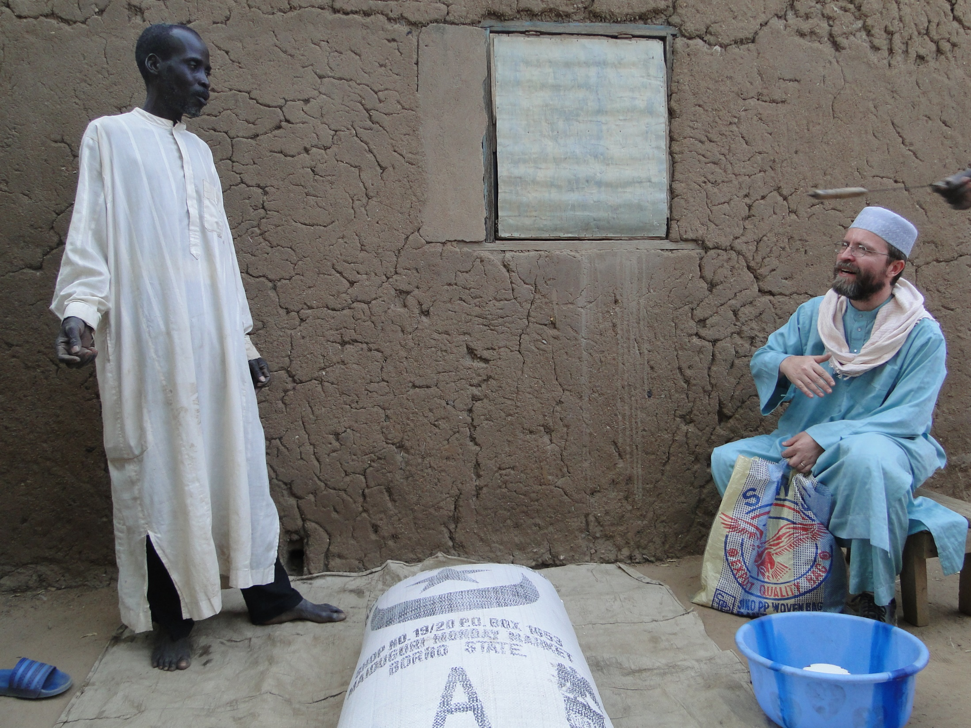
Why translate the Bible?

Slide 11
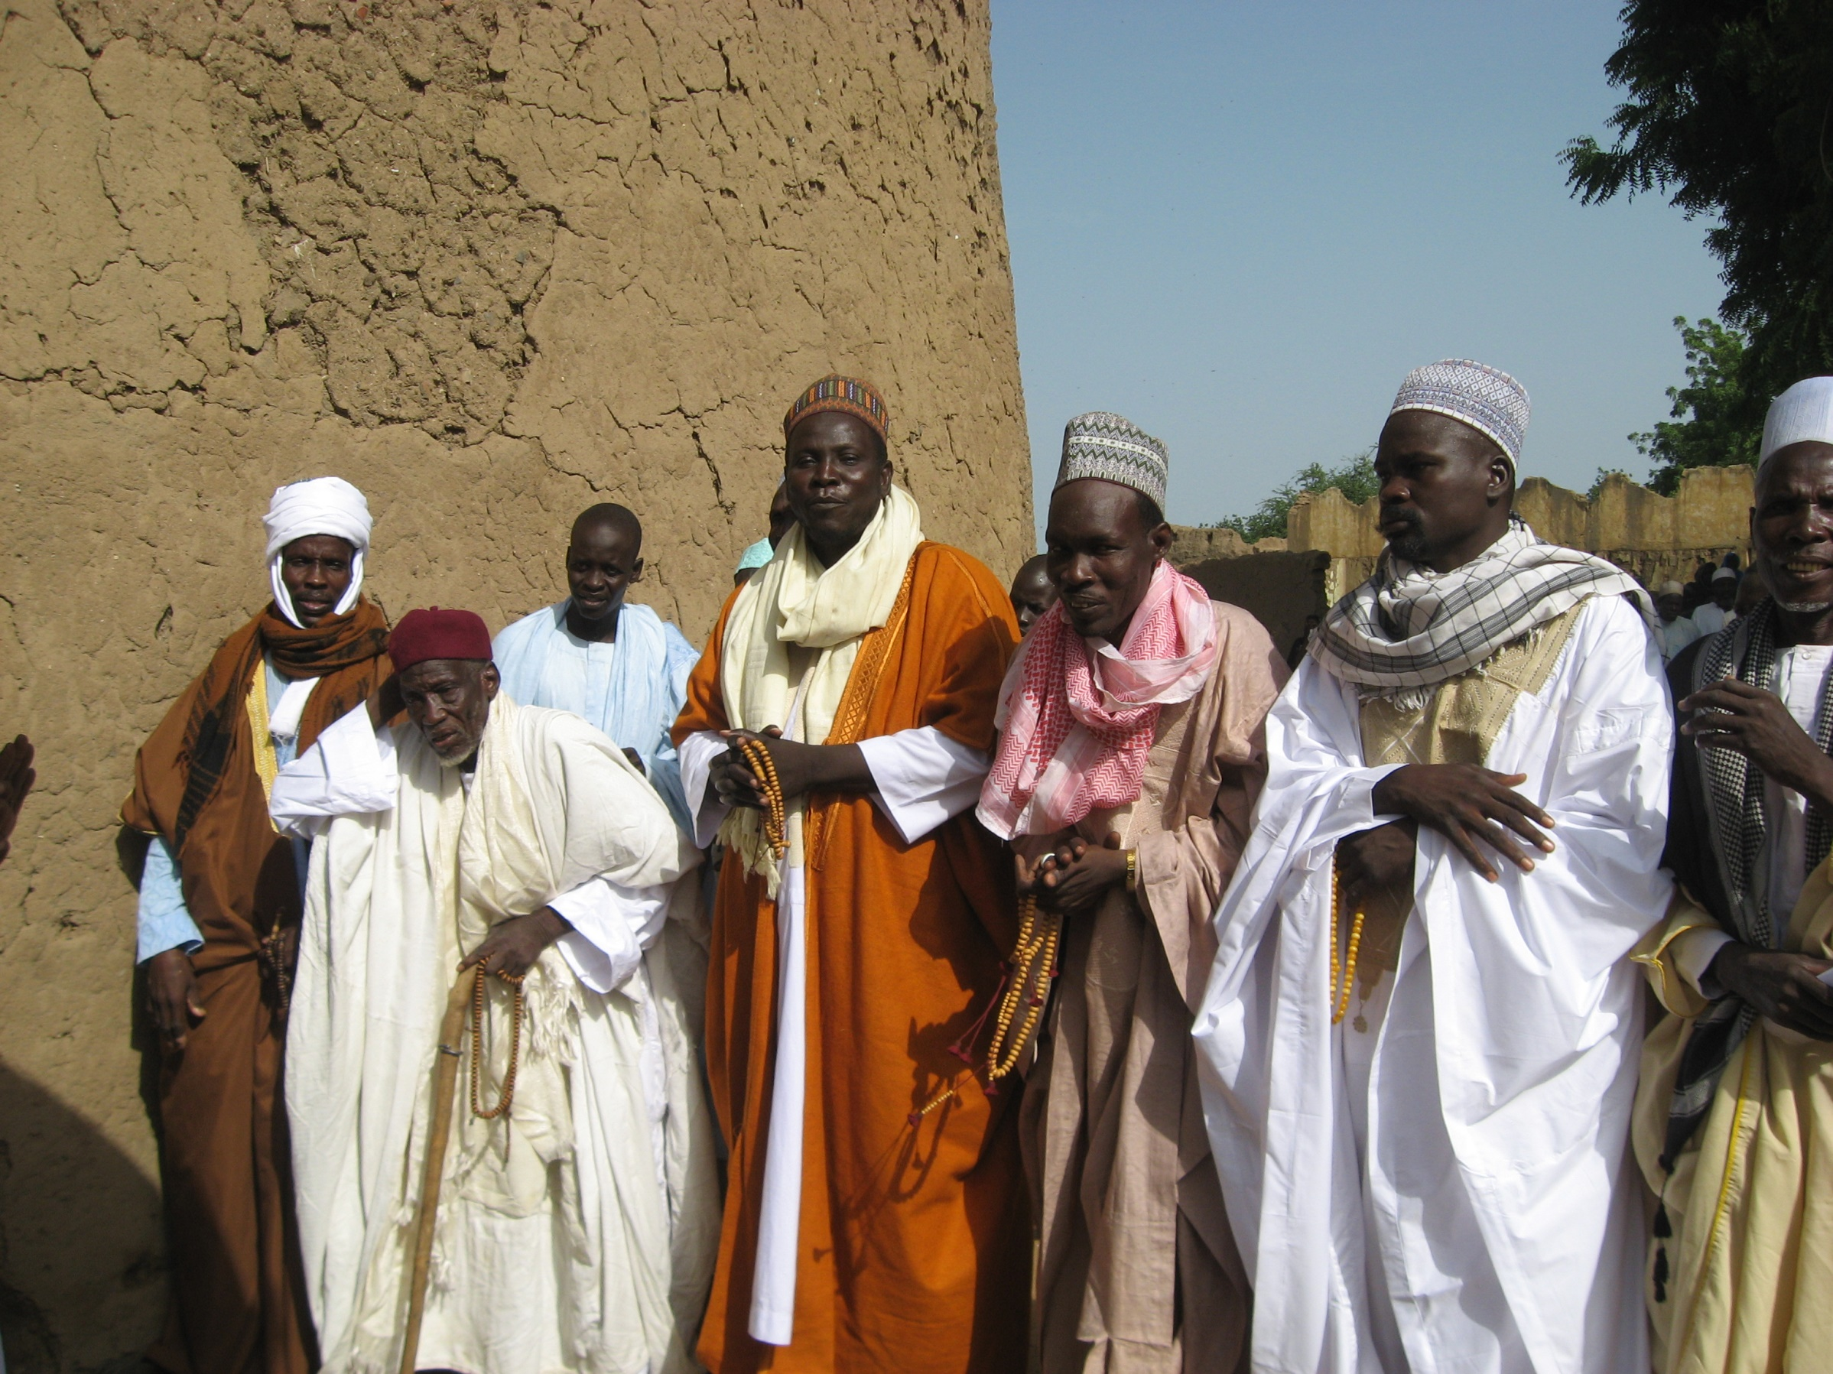
…because so many don’t have it!

Slide 12
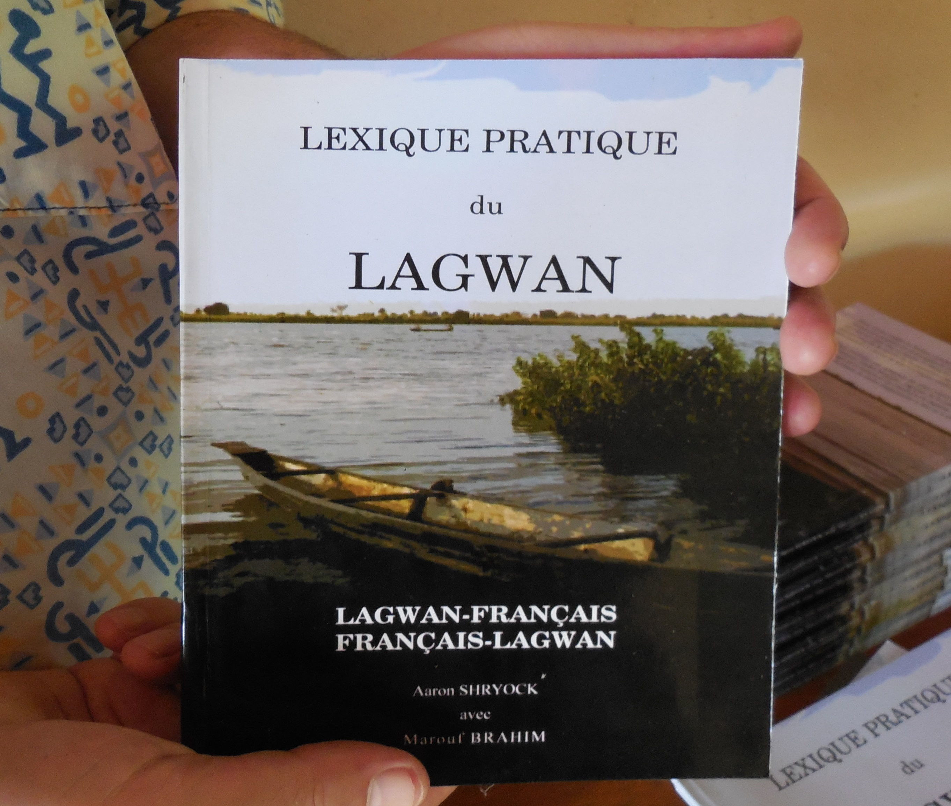

Slide 14
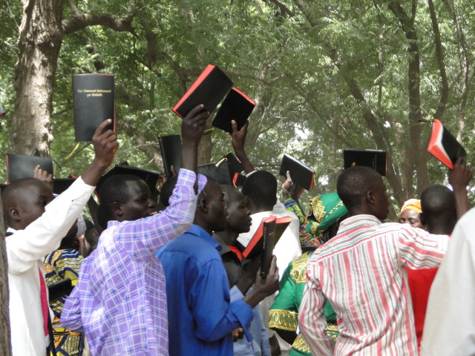
…because so many don’t have it!
college student went to Guatemala
Kaqchikel New Testament, 1930

Slide 15
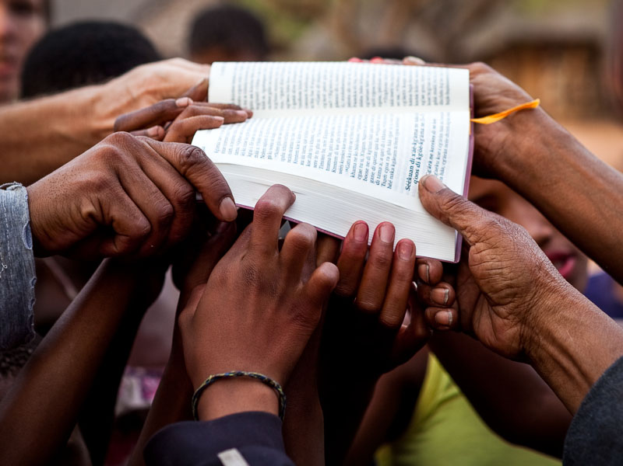
MI 750 Introduction to Bible Translation

Slide 16
Our!?
The Local Church and Bible Translation

